Slide 1
Objectives
In this session, you will learn to:
  Appreciate the Graphical User Interface (GUI)
  Identify the controls of GUI
Notes:
Start the session by sharing the session objectives with the students.

Slide 2

Appreciate the Graphical User Interface
What is a user interface?

Slide 3

Appreciate the Graphical User Interface (Contd.)
An interface is a layer between a user and an application. It helps the user to interact with the application.

Slide 4
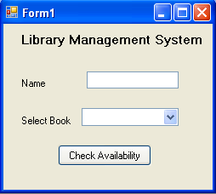
Appreciate the Graphical User Interface (Contd.)
The two types of user interface are:
  Character User Interface (CUI)
  Graphical User Interface (GUI)
In CUI, the user interacts with an application by typing commands.
The following figure shows the sample output of a CUI application.
A GUI provides a picture-oriented or graphical way of interacting with an application.
The following figure shows a sample output of a GUI application.
Enter your name: John
Enter a book name: Famous Five
Sorry, The book is not available.
Do you want to check for another book (y/n):
Notes:
Start the session by discussing the features of CUI based application. Ask the students to list down the possible disadvantages of CUI applications. Collate the answers given by the students and list down the following points:
The user needs to enter the data.
The user needs to remember the commands.
Lengthy code has to be written for simple tasks.
The display area is restricted to 25 rows and 80 columns.
Now take the discussion towards the GUI . Discuss the advantages of GUI as being WYSIWYG (What you see is what you get).
Discuss with the students that there are several controls available in GUI that can be used to take input from the user. This input can be validated easily.

Slide 5
Appreciate the Graphical User Interface (Contd.)
Advantages of GUI applications are:
  They are easy to learn and use.
  The users need not remember the lines of syntax.
  Most of the commands are executed by using mouse.
Notes:
Discuss the advantages of GUI applications listed here.

Slide 6
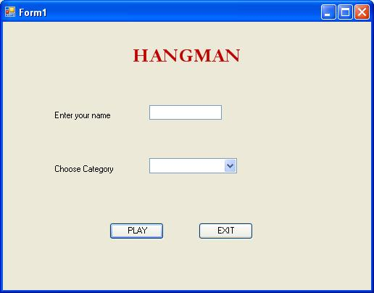
Identifying the Controls of GUI
A GUI application interacts with the users through various components, called controls.
The following figure shows a GUI screen containing various controls.
Text Box
Label
Combo Box
Button
Notes:
Some of controls that appear in the dialog box are explained in the following list.
Label: Displays text that users cannot directly edit.
TextBox: Accepts input from the user.
Combo Box: Displays items in a drop-down list. It is a combination of a text box in which a user types something, and a drop-down list from which the user selects an item.
Button: Provides options such as OK, Cancel etc.
Discuss with the students that there are 2 types of components, visual and non-visual components. Visual components are the ones which the users can see. They are also called as controls.

Slide 7
Just a minute
A ____________ is a control that consists of other controls.
Answer:
  Container
Notes:
Reiterate the concepts taught earlier by asking the given question.

Slide 8
Identifying the Controls of GUI (Contd.)
Windows provides the following types of dialog boxes:
  Modal
  System modal
  Modeless
Notes:
Discuss all the three types of dialog boxes with the students with appropriate examples.
Example of:
Modal: Save As Dialog Box, that does not allow to move the control else where unless the user selects some option or closes the dialog box
System Modal : Windows Log On Dialog Box, that takes control of the entire Windows Environment.
Modeless: Find and Replace Dialog Box, that stays on screen and is available for use at any time.

Slide 9
Identifying the Controls of GUI (Contd.)
Modal:
  It does not allow the user to switch focus to another area of the application, which has invoked the dialog box.
  It allows the user to switch to other Windows applications.
  The Save As dialog box of Microsoft Word is an example of modal dialog box.
Notes:
Discuss all the three types of dialog boxes with the students with appropriate examples.
Example of:
Modal: Save As Dialog Box, that does not allow to move the control else where unless the user selects some option or closes the dialog box
System Modal : Windows Log On Dialog Box, that takes control of the entire Windows Environment.
Modeless: Find and Replace Dialog Box, that stays on screen and is available for use at any time.

Slide 10
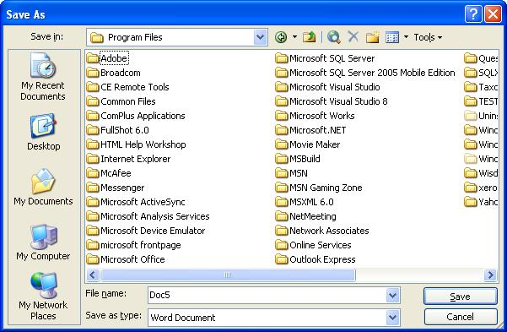
Identifying the Controls of GUI (Contd.)
The following figure shows the Save As dialog box.
Notes:
Discuss all the three types of dialog boxes with the students with appropriate examples.
Example of:
Modal: Save As Dialog Box, that does not allow to move the control else where unless the user selects some option or closes the dialog box
System Modal : Windows Log On Dialog Box, that takes control of the entire Windows Environment.
Modeless: Find and Replace Dialog Box, that stays on screen and is available for use at any time.

Slide 11
Identifying the Controls of GUI (Contd.)
  System modal:
  It takes control of the entire Windows environment.
  It does not allow the user to switch to any other Windows application until it is closed.
  The Log On to Windows dialog box is an example of system modal dialog box.
Notes:
Discuss all the three types of dialog boxes with the students with appropriate examples.
Example of:
Modal: Save As Dialog Box, that does not allow to move the control else where unless the user selects some option or closes the dialog box
System Modal : Windows Log On Dialog Box, that takes control of the entire Windows Environment.
Modeless: Find and Replace Dialog Box, that stays on screen and is available for use at any time.

Slide 12
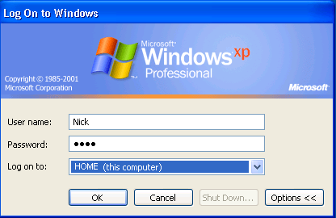
Identifying the Controls of GUI (Contd.)
The following figure shows the Log On to Windows dialog box.
Notes:
Discuss all the three types of dialog boxes with the students with appropriate examples.
Example of:
Modal: Save As Dialog Box, that does not allow to move the control else where unless the user selects some option or closes the dialog box
System Modal : Windows Log On Dialog Box, that takes control of the entire Windows Environment.
Modeless: Find and Replace Dialog Box, that stays on screen and is available for use at any time.

Slide 13
Identifying the Controls of GUI (Contd.)
  Modeless:
  It allows the users to switch to another area of the application or to another Windows application.
  It remains on the screen and is available for use at any time.
  The Find and Replace dialog box of Microsoft Word is an example of modeless dialog box.
Notes:
Discuss all the three types of dialog boxes with the students with appropriate examples.
Example of:
Modal: Save As Dialog Box, that does not allow to move the control else where unless the user selects some option or closes the dialog box
System Modal : Windows Log On Dialog Box, that takes control of the entire Windows Environment.
Modeless: Find and Replace Dialog Box, that stays on screen and is available for use at any time.

Slide 14
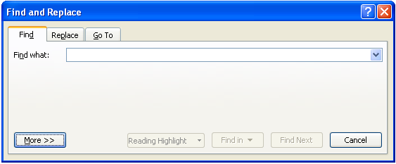
Identifying the Controls of GUI (Contd.)
The following figure shows the Find and Replace dialog box.
Notes:
Discuss all the three types of dialog boxes with the students with appropriate examples.
Example of:
Modal: Save As Dialog Box, that does not allow to move the control else where unless the user selects some option or closes the dialog box
System Modal : Windows Log On Dialog Box, that takes control of the entire Windows Environment.
Modeless: Find and Replace Dialog Box, that stays on screen and is available for use at any time.

Slide 15
Just a minute
Which dialog box allows users to switch to another area of the application, which has invoked it?
Answer:
  Modeless dialog box
Notes:
Reiterate the concepts taught earlier by asking the given question.

Slide 16
Just a minute
A __________ acts as a container for a group of related controls.
Answer:
  Dialog box
Notes:
Reiterate the concepts taught earlier by asking the given question.

Slide 17
Identifying the Features of the Windows Environment
The features of the Windows environment that enable applications to interact effectively with the user are:
  Event-driven programming
  Dynamic linking
Notes:
Using this slide, discuss with the students that all windows based applications accept the input and process the input on the basis of an event. Take a simple example of adding two numbers. For this application, the user enters two numbers in the text boxes. Only when he clicks on the button, will he be able to see the results of addition. Here, clicking of a button is an example of an event being generated.
Now proceed the discussion towards another example of Student’s Data Entry form. After entering all the values in the required fields, the user needs to ensure the data is transferred into the database. The code to transfer the database will be written on the click event of the button. Therefore, after entering the data, the user needs to click on the button to transfer the data to the database.
In addition, also discuss with the students that Windows Applications allow to link the application to the existing library function. For example, there is a library function to connect to the desired database where the user needs to just specify the name and location of database. Therefore, instead of writing the code again and again, the user can use the in-built function and connect to the database quickly.

Slide 18
Identifying the Features of the Windows Environment (Contd.)
  Event-driven programming:
  Windows application can execute programs on a click of a mouse. An event is an action performed by the user.
  Windows applications generate messages in response to each action performed by the user.
  Depending on the messages received, the application performs preprogrammed functions.
  Based on user’s input, an event gets generated. The code corresponding to the event is executed.
Notes:
Using this slide, discuss with the students that all windows based applications accept the input and process the input on the basis of an event. Take a simple example of adding two numbers. For this application, the user enters two numbers in the text boxes. Only when he clicks on the button, will he be able to see the results of addition. Here, clicking of a button is an example of an event being generated.
Now proceed the discussion towards another example of Student’s Data Entry form. After entering all the values in the required fields, the user needs to ensure the data is transferred into the database. The code to transfer the database will be written on the click event of the button. Therefore, after entering the data, the user needs to click on the button to transfer the data to the database.
In addition, also discuss with the students that Windows Applications allow to link the application to the existing library function. For example, there is a library function to connect to the desired database where the user needs to just specify the name and location of database. Therefore, instead of writing the code again and again, the user can use the in-built function and connect to the database quickly.

Slide 19
Identifying the Features of the Windows Environment (Contd.)
  Dynamic linking:
  The process by which an application is linked to the library functions at run time.
  The reference to the function is looked up at run time. This is called dynamic linking.
Notes:
Using this slide, discuss with the students that all windows based applications accept the input and process the input on the basis of an event. Take a simple example of adding two numbers. For this application, the user enters two numbers in the text boxes. Only when he clicks on the button, will he be able to see the results of addition. Here, clicking of a button is an example of an event being generated.
Now proceed the discussion towards another example of Student’s Data Entry form. After entering all the values in the required fields, the user needs to ensure the data is transferred into the database. The code to transfer the database will be written on the click event of the button. Therefore, after entering the data, the user needs to click on the button to transfer the data to the database.
In addition, also discuss with the students that Windows Applications allow to link the application to the existing library function. For example, there is a library function to connect to the desired database where the user needs to just specify the name and location of database. Therefore, instead of writing the code again and again, the user can use the in-built function and connect to the database quickly.

Slide 20
Summary
In this session, you learned that:
  GUI enables the users to interact with the application by using graphical components.
  Windows provides three types of dialog boxes:
    Modal dialog box
    System modal dialog box
    Modeless dialog box
  The main features of the Windows environment are:
    Event-driven programming
    Dynamic linking
Notes:
You can summarize the session by using the summary given in the slides.
In addition, you can also ask students summarize what they have learnt in this session.

